Slide 1
Heuristics, local search
AI3
Mária Markošová

Slide 2
What we know
Uninformed search, BFS, DFS, uniform cost search, complexity, properties.
Informed search, heuristics.
Greedy search, A*, complexity, properties.
Graphsearch, treesearch implementation, differences.

Slide 3
Poznámka ku dvom spôsobom implementácie Graphsearch algoritmu.
Pôvodné
8) Rozvinieme bod n , vytvoríme množinu nasledovníkov M, ktorí ale nie sú v
zozname CLOSED. Vytvoríme reprezentáciu hrán medzi n a členmi M.
Vo chvíli, keď pridávam uzol do Open, kontrolujem, či už nie je v Closed zozname. Ak je, preskočím ho.
Zjednodušené: Nekontrolujem či je uzol v Closed pri pridávaní do Open, ale pridám tam
všetky uzly. Tak sa napr. uzol G môže vyskytnúť v Open viackrát. Keď ho
spracujem prvýkrát, pridám ho do Closed. Keď sa ho pokúšam spracovať
znovu (pri ďalšom výskyte v Open), skontrolujem, či nie je v Closed. Ak
je, preskočím ho. Closed kontrolujem pri vyberaní uzla z Open.
Zložitosť algoritmu sa nemení, ale pri druhej implementácii menej krát kontrolujem zoznam Closed. Prečo? Pretože pri druhej implementácii sa k mnohým bodom z Open algoritmus ani nedostane, lebo nájde riešenie skôr.

Slide 4
Outline
Heuristics in more details.
Local search - principle
Local search algorithms (hill climbing, genetic algorithm, simulated annealing)

Slide 5




Heuristic functions: (8 puzzle example)
1
2
3
Typical solution for randomly chosen initial state : 22 steps,
Typical branching:
Searching all states till the depth 22:
goes through states
8
4
7
6
5
Number of different solvable states for 8 puzzle: 181 440= 9!/2
Number of different states for 15 puzzle:
Good heuristics is important

Slide 6


Possible heuristics h always reflects the problem, but the same way relaxes some constraints. Admissibility is a necessary property.
h: 1. - number of tiles in a bad positions
2. - sum of horizontal and vertical distances from the good position of
the tile (manhattan distance)-
Both are admissible, that means they do not overestimate the real distance to the goal

Slide 7
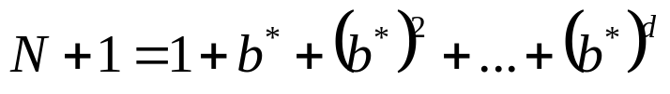

Quality of heuristics
Effective branching factor b*
N – number of nodes expanded by A* with a given heuristics
d – depth of the tree
Equation for the b calculation b*
Good heuristic gives:

Slide 8


8 puzzle comparison
Cena cesty
Efektívny faktor vetvenia
d
IDS
A*
A*
IDS
A*
A*
10 6 6 2.45 1.79 1.79
4 112 13 12 2.87 1.48 1.45
680 20 18 2.73 1.34 1.30
6384 39 25 2.80 1.33 1.24
47127 93 39 2.79 1.38 1.22
12 3644035 227 73 2.78 1.42 1.24
IDS: iterative deepening search, variant of DFS

Slide 9

How to find an admissible heuristics by the problem relaxation
-problem with less constraints relaxed problem
Example:
Let us admit, that the tile in the 8-puzzle can “jump” at an arbitrary position. , the number of tiles in a bad position, gives therefore an exact cost for this relaxed variant, gives an exact cost of the most effective solution.
How we relaxed the problem in the case of the Romanian map (strait line distance heuristics)?

Slide 10
Number of tiles in a bad position : 3
1
3
4
2
5
6
7
8
And what about h(2) ? How did we relaxed the problem here?

Slide 11
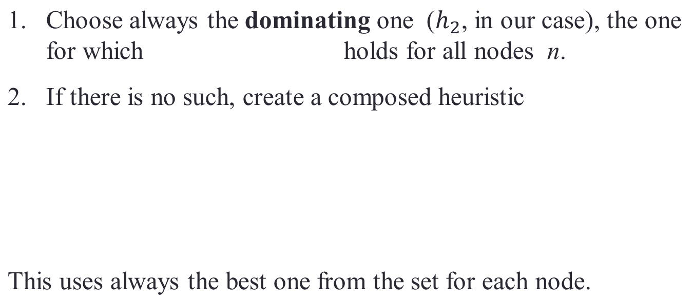
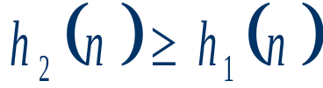

How to choose heuristics if we have more then one admissible ones?

Slide 12
How to find heuristics by solving a subproblem?
(subproblem – put 1,2,3,4 tiles on a correct positions)
2
4
-subproblem to 8 puzzle
find an optimal solution
it’s cost is an estimate from below to the total solution cost
put it into the database
use as a heuristics, in a case if the subproblem appears during the real problem solution
3
1

Slide 13
Algorithms of the cyclic improvement
They solve optimization problems. In these problems the state itself is important, the path is not a part of the solution.
Examples: n queen problem- how to place n queens on a n x n chessboard, how to place integrated circuits on a board etc.
Fitness or objective, evaluation function of the intermediate state is evaluated, the goal is to find a state having the optimum of the fitness, objective function.

Slide 14
The basic principle of the local search (cyclic improvement of the state)
Local search:
We start from an initial state, which is evaluated with a help of some evaluation function.
Perturbing the current state, neighbor states are generated and evaluated. The best one of them is then chosen according the evaluation. The path to the best state is forgotten. The best state is then either accepted according some known criteria, or:
Current best state is perturbed and the algorithm continues from 2.
These algorithms are appropriate for the optimization problems solution.

Slide 15
Optimization problem
To solve an optimization problem means to find an optimum (maximum or minimum of some function). If this function is complex, unknown analytically, we can do that numericaly with a help of optimization algorithms.
In our case we seek an optimum of the evaluation function in a space of states.

Slide 16

Example: n-queen problem
Put n queens on n × n chessboard. None of them can attack themselves.
Let h be the number of pairs of queens that can attack each other. Evaluation function gives each state its value h. We look for the state with h=0, minimum.

Slide 17
Illustration of the problem (1d)
Red curve is an evaluation function, it is called landscape of values, fitness landscape, objective function landscape. It depends on the problem formulation.
optimum
Evaluation function
0
Initial state
Perturbed state 2
Perturbed state 1
Chessboard states

Slide 18
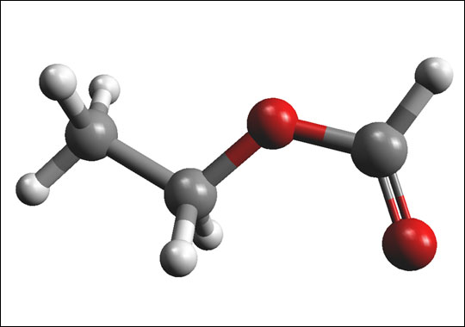
Example: Seeking for an optimal structure of an organic chemical. Optimal means, a structure for which a maximum energy is necessary to disintegrate it.
Constrains: Rotating and bending the bonds is possible in certain interval.

Slide 19
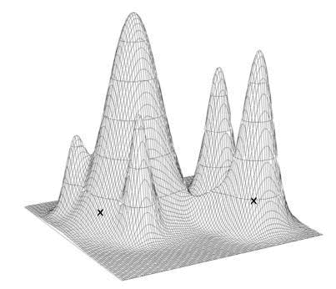
2d illustration of the problem
energy
Perturbed state 2
Perturbed state 1
Initial state
bending
rotation

Slide 20
Example: Seeking for the best shape of the car. Best in a sense that it causes the smallest air resistance.
Evaluation of the shape (state) quality is due to the fact what air resistance and friction gives the shape in question. Another properties can influence that as well. Changing shape or other properties, such as lacquer one can change the air resistance and friction. This can be measured in the air chamber.

Slide 21
Algoritmhms of local search
Paradigmatic example: n queens.
Generate and test algorithm
Generate several random solutions (placements of n queens) on n x n chessboard.
Evaluate each state with an evaluation function (sum all pairs of the attacking queens)
Forget all solutions except of the best one until now (the one with the least number of the attacking queens).
Repeat from 1 until the stop condition is met (for example number of maximal iterations 1.
The solution is the overall best state.

Slide 22
Hill climbing algorithmus
On the state surface we always go in a direction which makes our local state better:
Traps: 1. local maxima
2. plateau
3. ridge
Algorithm likes to cycle; good for state surfaces with small amount of extrema.
How to awoid cycling? Multiple starts from different initial states

Slide 23

Hill-climbing search (Russell, Norwig)
"Like climbing Everest in thick fog with amnesia„

Slide 24

Hill-climbing search
Problem: solution depends on the initial state, gets often stuck in a local optimum.

Slide 25
Hill climbing
Choose an initial state and evaluate it.
From the initial state generate m new states by perturbation of the initial state. Evaluate all of them
In the most simple hill climbing only the best state is chosen. The other ones are forgotten. The best state will be a new initial state.
Repeat from 2.
Stop according the stopping criterion.

Slide 26

Hill-climbing search: 8-queens problem
h = number of pairs of queens that are attacking each other, either directly or indirectly
h = 17 for the above state

Slide 27

Hill-climbing search: 8-queens problem
A global minimum with h = 0

Slide 28
Hill climbing algorithm is
noncomplete, does not find the solution always, can get stuck
how to avoid this: generate several initial states and run hill climbing separately from each of them
if the number of restarts is infinite, algorithmus
finds a solution with probability close o 1

Slide 29
Genetic algorithmus
Inspired by the natural evolution, Darwinian evolutionary paradigma
Individual in the population is represented by a string of symbols, chromosomes, in which the genetic information is encoded. Each individual has certain ability to survive, according which we can evaluate him. Let us take the most simple case, individual is represented by exactly one chromosome.
Population is a set of individuals represented by the vector of symbols / chromosome
During the reproduction the parents are selected by a natural selection (the better the individual, the more probable it is to be selected as a parent).
Then the parent genetic information is recombined (crossover) and mutated.

Slide 30
Genetic algoritmus
Starts with k randomly generated states (population).
Each state is represented by the “chromosome”.
Evaluation of the population individuals.
New state is created with a help of the reproduction process. Parent states for the reproduction are chosen with respect of their value. The greater the value, the greater is the probability to be chosen as a parent.
Reproduction= crossover +mutation.
The reproduction process creates new individuals which replace the old ones either entirely or partly.

Slide 31
Example: ; we are seeking its secondary structure which needs maximal energy to be destroyed. The structure can be changed by bending and rotating some of the bonds.
Constrain: Rotation and bending is possible only in some limits.

Slide 32
Population generation
a
b
Different structures energy
-----------------------------------------------------------------------------
x1=(a1,b1) h1
x2=(a2,b2) h2
.
.
.
xn=(an,bn) hn

Slide 33
Reproduction
Selection
Parent 1: x10=(a10,b10)
Parent 2: x16=(a16,b16)
Chosen with respect to the value of energy
Crossover
Successors after the crossover: xa1=(a16, b10)
xa2=(a10,b16)
Mutation
Succesor after the mutation xa11=(a16, b10+delta)
Reproduction process runs as many times as we need for the creation of enough new individuals

Slide 34

Ilustration in 2d
energy
Init . population: several molecules in different states, combination of angles.
Population after the reproductioni
init. population
bending
rotation

Slide 35

Another example: 8 queen problem, evaluation function evaluate the number of queen which are attacking themselves
State is represented by the string of symbols (chromosom):
(3,2,7,5,2,4,1,1)
Tell me, looking at the picture, what these numbers mean.
Position in a string means a column, number denotes the number of row (from the player point of view)

Slide 36

Genetic algoritmus)
8 queen problem, according Russel and Norwig
Gives evaluation of the position

Slide 37
Genetic algorithm- crossover

Slide 38
Genetic algorithm
GA is not optimal, often finds local optimum, not a global one
Problems of GA / next example.

Slide 39

Example
Let us have a network of hexagonal rooms, each room has 6 doors. In some of them is a treasure.
In the middle room is a treasure finder. He can make 10 steps, each in six possible directions.
S
SZ
SV
JZ
JV
J
The finder task is to find such path, which visits as many treasure rooms as possible. Ideally all 10, but he can stop finding six.

Slide 40

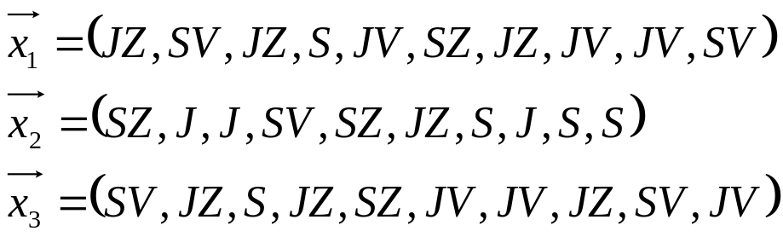
Chromosome, represents individual ?
Evaluation of the chromosome?
Number of rooms visited by the individual .
Population?
Set of individuals, chromosomes representing movement codes
Initial population
Stopping condition?
If we find an individual, chromosome, path which visits 6 treasure rooms.

Slide 41
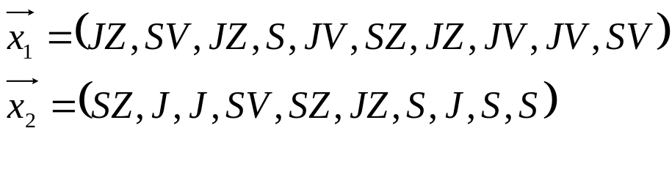
Fitness value of individuals (due to the evaluation) is 3, 3, 2. Average fitness in an initial generation is 2.67 .
Selection: The greater the fitness the higher probability to be selected as a parent.
Selection probability in an initial population?
3/8, 3/8, 2/8
Selected parents
Crossover :

Slide 42
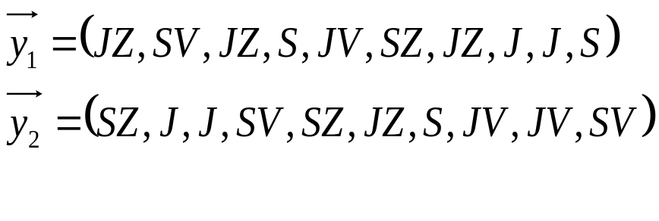
Successors after
the crossover
S
Successors after
the mutation
S
S
Fitness: 2
4
Replacement of the initial generation: From the initial and new chromosomes choose 3 with the highest evaluation value (fitness). If there is a chromosome with the value 6 (six visited treasure rooms), stop. We have a solution. If not, continue.

Slide 43
Space of chromosomes and searching space.
Space, set of chromosomes: is connected to the encoding of the problem parameters and algorithm able to work with this encoding.
Searching space: reflects the problem we solve
Decoding is sometimes necessary among these two spaces:
Example : Treasure world
Space (set) of chromosomes: Each chromosome is a string of direction symbols. Looking at such string we do not know the value of the string, how many treasure room the path encoded by the string visited. We do not know the fitness of individual.
Searching space: rooms in which the finder moves
Decoding

Slide 44

Are we able to find such chromosome encoding, that both spaces are identical (we do not need decoding)?
Number the rooms.
Let the treasure is in rooms number 2, 4, 5, 11, 13, 15, 17, 19.
Chromosome is encoded as a vector of room numbers visited by the finder.
In this representation the chromosome value is directly visible =3 (3 rooms with the treasure were visited).
But there is no free lunch! What problems can arise in a reproduction process with this encoding?

Slide 45


Simulated annealing
Idea: The worse state is allowed during the solution of the problem, but only with certain probability.

Slide 46
A bit of physics
How to put sugar cubes into a box? Try this method
1. Pour cubes into a box. They take random positions.
2. Than shake the box, until we get the configuration of the sugar cubes
positions having the minimal potential energy.
What box shaking means?
If we want to get an appropriate cube positions with a low potential energy, we shake, that means we create transient position configuration, which might have even greater or high potential energy.
This is the principle of the simulated annealing.

Slide 47
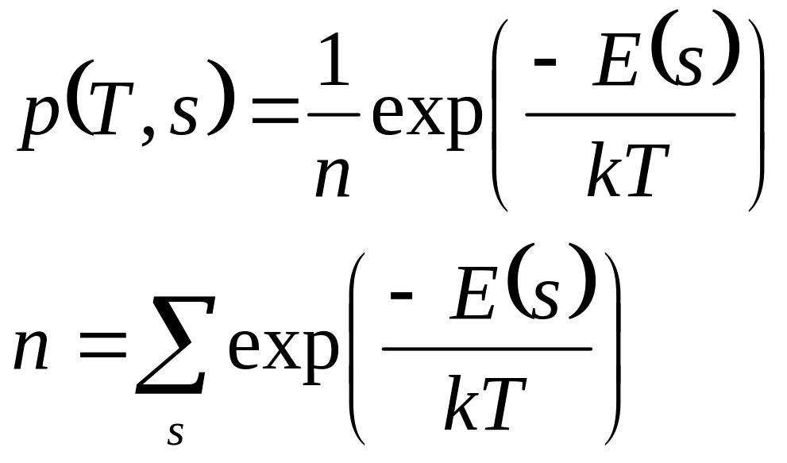
Distribution of configurations of the set of distinguishable particles at the temperature T is given as:
E – free energy
T – temperatura
k- Boltzman constant

Slide 48
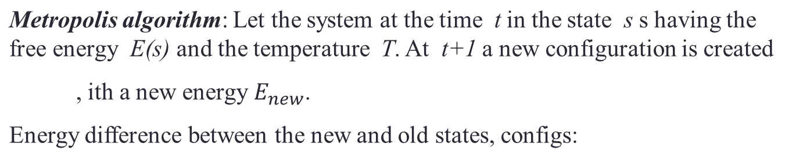

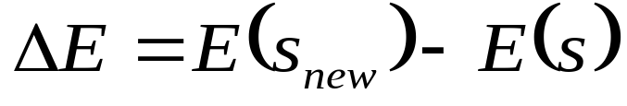


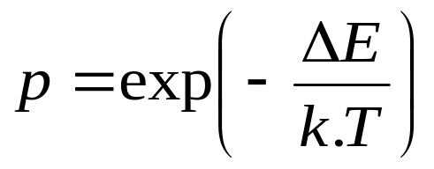
If accept the new configuration with the probability 1.
If accept the new configuration with the probability p

Slide 49
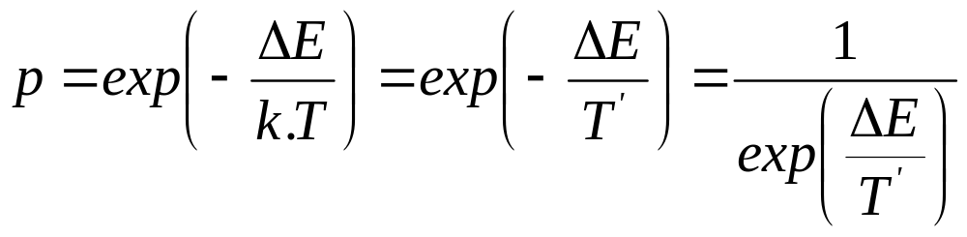
What is „energy“ in the simulated annealing?
It is a function in which we want to find a minimum (sum of the blackberries potential energies, path between the towns in the traveling salesman problem, evaluation function in the n-queen problem etc.)
.
What is „temperature“ in the simulated annealing?
It is a constant governing the acceptance of a “worse” configuration, state.

Slide 50
Example – traveling salesman problem.
1
1
6
2
6
2
5
3
5
3
4
4
s=(1,2,5,4,3,6,1)
Initial configuration
Perturbed initial configuration
f(s) – function we want to minimize, distance between the towns

Slide 51
Create town ordering (configuration)
Calculate the path length for this configuration. This is „energy“ – function, we want to find a minimum of.
Disturb initial configuration; if the path among the towns is then longer, regulate the temperature so, that the probability of acceptance of this worse stat is close to one.
Repeat m times at this temperature.
Lower the temperature and thus the acceptance probability of a longer path config and repeat the process at this new temperature.

Slide 52
Algorithm
Algorithm SIMULATED-ANNEALING
Begin
temp = INIT-TEMP; put an initial temperature
konfig = INIT-konfig; initial configuration
while (temp > FINAL-TEMP) do
while (inner_loop_criterion = FALSE) do
new_konfig = PERTURB(konfig);
ΔE = E(new_konfig) -E(konfig);
if (ΔE < 0) then
konfig = new_konfig;
else if (RANDOM(0,1) > e^{-(ΔE/temp)}) then
konfig = new_konfig;
temp = SCHEDULE(temp);
End.

Slide 53
Simulated annealing search properties
It is possible to prove mathematically , that if the temperature T decreases infinitely slowly, then the simulated annealing finds global optimum with the probability close to one .
Simulated annealing is used in layout problems, planning problems etc.

Slide 54
Summary
How to find a good heuristic
Local search principle
Algorithms (generate and test, hill climbing, genetic, simulated annealing )

Slide 55
Tasks to think about
Let us have a map of Europe. We have three different colors. The goal is to color the states by such a way, that two neighbor states do not have the same color. Formulate as a searching problem.
What is state ? How many different states we have?
What is a goal state?
What is a state space?

